Slide 1
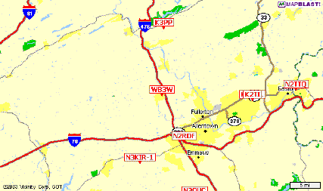
APRS
An Introduction to APRS

Slide 2
WHAT WILL BE COVERED
Acknowledgements
WHAT IS APRS?
APRS NETWORK
Typical Equipment Setup
Visualizing APRS Data
Software for APRs
Links to Further APRS Information
Question & Demonstration

Slide 3
What Won’t be Covered
Bicycle rallies, races
Walk-a-thons, Parades
Skywarn
Weather Nets
Crime prevention patrols
Damage assessment
Direction Finding – Foxhunts
Balloon tracking
APRS and satellites
Universal text messaging
For much more information see WWW.APRS.ORG

Slide 4
Acknowledgements
Bob Bruniga of course
Tim Watson KB1HNZ & Ryan Michaelson KB1YTR
Guy Story, KC5GOI

Slide 5
What is APRS?
APRS stands for Automatic Packet Reporting System (although it is frequently also called Automatic Position Reporting System.)
APRS was developed in the early 1990's by Bob Bruninga, WB4APR, for tracking and digital communications with mobile GPS equipped stations utilizing Amateur two-way radio.
APRS has been around for 25 years

Slide 6
Bob Bruninga – “Father of APRS”
His first experimental protocol was run on a VIC-20 program in 1984 to report the position and status of horses in a cross country endurance run for AMRAD
He developed the current APRS protocol as part of his research for the US Navy while an Instructor at the Naval Academy in Annapolis, MD. to assist in tracking boats in races on the local waterways.

Slide 7
Bob Bruninga – “Father of APRS”
The predecessor to the current “APRS” protocol was named APLS and released in 1991.
He is still very active today, and continues to provide support and set standards.

Slide 8
What is APRS all about?
The APRS System was developed in order to assist amateur radio operators in tracking and monitoring position data.
An original intent for APRS is its messaging capabilities, which can work even in a disastrous time when the Internet is down.
APRS can be used to transmit location data, course and speed info, and weather information in a timely fashion using a packet network.

Slide 9
More “About APRS”….
The Automatic Packet Reporting System consists of a very large land based wireless network.
This network has nodes nearly every 20-30 miles that relay signals through digipeaters.
APRS is used in space to track satellite data and GPS information from onboard GPS receivers.
It is also used to monitor telemetry values of weather stations for the National Weather Service (NWS)
APRS has the capability to quickly relay telemetry values to research centers without the Internet.

Slide 10
Different than Regular Packet
It uses graphical mapping and other data displays.
All communications use a “one-to-many protocol” so everyone is updated in real time.
Generic digipeating so knowledge of the network isn’t required.
APRS turns packet radio into a real-time tactical communications and display system for emergencies and public service applications.

Slide 11
What Equipment is required?
APRS was developed to work in a mobile environment, so it was designed to only use three pieces of hardware.
This consists of a transmitter/receiver (Transceiver), a Global Positioning System (GPS), and a terminal node controller (TNC).

Slide 12
Basic Equipment
A VHF Amateur Radio Transceiver operating on 144.390 Mhz. (USA).
Must be a “transceiver” as APRS uses a collision detection system to know when to send data.
Range of coverage depends on the power of the transmitter.

Slide 13
Basic Equipment
A standard GPS (Global Positioning System) unit.
There are 24 orbiting satellites used to pinpoint anyone's specific geographic location.
They also provide ground speed and altitude measurements.

Slide 14
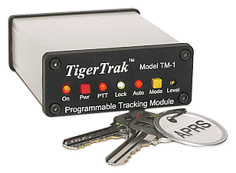
Basic Equipment
A TNC which is basically a radio (or “RF”) modem.
The TNC connects the transceiver to a GPS converting it’s data into AX.25 Packet protocol.
“TinyTracs” are simple “Transmit Only” stand alone APRS TNCs

Slide 15
Various Mobile Setups
Mobile Tracking Installations utilize a GPS connected to the radio through the TNC interface,
The new “APRS Ready” transceivers like Kenwood’s TM- D700 have their own built in TNC.

Slide 16
Various Portable Setups
A Portable Tracker is usually low powered and may need a nearby digipeater.
These units work well with bike-a-thons, parades and other community events, along with search & rescue operations and weather nets.

Slide 17
Weather Station Setups
Weather station setups with APRS are similar to the normal setups,
However, the GPS unit is usually replaced by outside Weather Monitoring Equipment.

Slide 18
All-IN-ONE RADIOS
Mobiles
Kenwood TM D710G
Yaesu FTM 400XDR
Yaesu FTM 100DR
Alinco DR 135T
Handhelds
Kenwood TH-K20A
Yeasu FT2 DR
Yaesu FT3 DR

Slide 19
And Another Method…
Uses PC sound card to transmit and receive signals from radio – No TNC or GPS required
AGWPE is an excellent Sound card interface for Packet Radio available free on the Internet.
Simple interface circuitry (The same as PSK31).
Requires a modest computer to operate

Slide 20
Setting up your system
Get the RF part set to simplex on 144.39
Get the interface between radio and Software talking
Set your callsign-SSID in the software
Set the Path to:
Wide2-2 for fixed stations
Wide1-1,Wide2-1 for mobiles

Slide 21
How does the Signal Travel?
Aa
Direct

Slide 22
How does the Signal Travel?
Aa
Direct and DigiPeaters

Slide 23
How does the Signal Travel?
Aa
Straight through the DigiPeater

Slide 24
How does the Signal Travel?
Aa
Multiple Hops

Slide 25
How does the Signal Travel?
Aa
And to the Internet Gateway

Slide 26
Utilizing an IGate
An IGATE is a local APRS station that utilizes the APRSserve network to pass all packets heard on their local RF back to the Internet.
It can also act as a gateway to pass messages addressed to local RF stations from Internet only stations.

Slide 27
Mapping/Tracking Programs
Dos-APRS Bob Bruninga
WinAPRS Mark Sproul
MacAprs Keith Sproul
APRS+SA Brent Hildebrand
UI-View Roger Barker
Xastir Open Source
XAPRS Sproul Brothers
PocketAPRS Mike Musick

Slide 28
UI-View
UI-View uses bitmap images for its maps. Also, the 32 bit version supports Precision Mapping.
It supports TNCs in KISS mode and AGWPE host mode in addition to terminal mode - and host mode allows up to 16 RF ports.
UI-View has a full-featured intelligent digipeater.
UI-View has full support for connecting to APRS servers on the internet.
UI-View is open architecture. A number of other software developers have written add-on applications providing additional functionality.

Slide 29
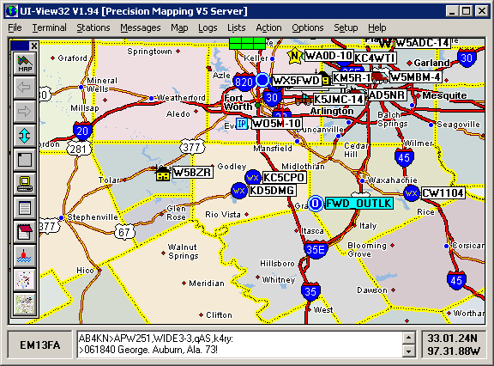
UI-view
Whether it is used just for WX, or display only, or full TX /RX/internet. UI-View is more than capable.
It can be configured as a digipeater to relay packets.
With plug-ins, UI-View can receive NWS warnings and plot them on the map.
UI-View can really shine in the emergency or event communications role.

Slide 30
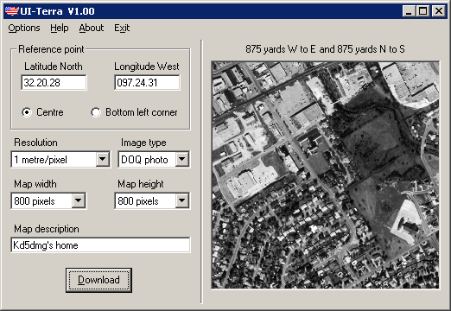
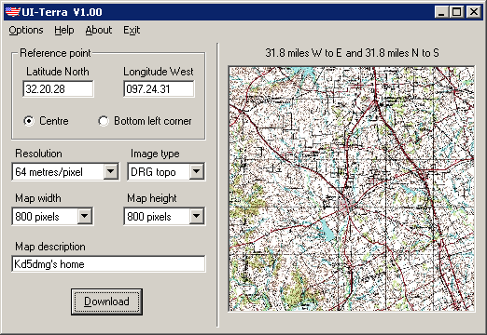
UI-view Maps
Full support for Precision mapping, plus you can “capture” many other mapping programs.
SA virtual map. It makes it very easy to grab maps from Street Atlas V4, V5, V6, V7, V8 and V9
UI-Terra add-on allows you to make maps from Terraserver.

Slide 31
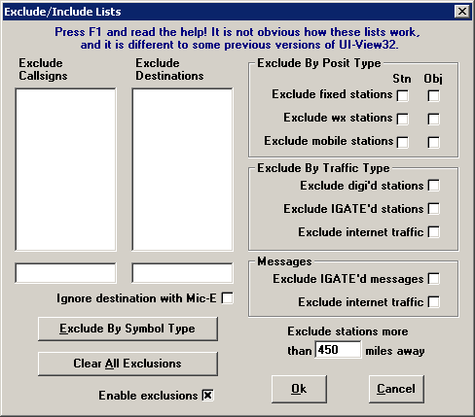
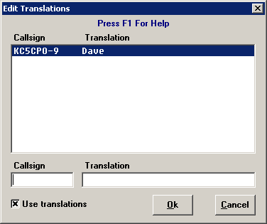
UI-View Events Operation
Exclude/include lists. Here you can choose to exclude everything except mobile stations.
Tactical calls -- you can assign labels to call signs.
With a plug-in, you can draw an object on the map and transmit it over APRS. This is great for a race route.

Slide 32
Links to Further APRS info
http://www.aprs.org/
https://aprs.fi/#!mt=roadmap&z=11&lat=41.6615&lng=-93.6125&timerange=3600&tail=3600
Search Google for “APRS presentations”

Slide 33
Credits
Thanks to the following for earlier research and presentations on APRS…….
John Beadles N5OOM
Tony Campbell W5ADC
Pete Loveall AE5PL
Bob Bruninga WB4APR

